Slide 1
Chapter Two: Threats and Attacks
Points to be Discussed:
Threats
Methods to Identify Threats
Attacks
By Asfaw K.

Slide 2
Threats
The goal of computer security is protecting valuable assets.
To study different ways of protection, we use a framework that describes how assets may be harmed and how to counter or mitigate that harm.
A potential for violation of security, which exists when there is a circumstance, capability, action, or event that could breach security and cause harm.
That is, a threat is a possible danger that might exploit a vulnerability.
A threat to a computing system is a set of circumstances that has the potential to cause loss or harm.
Generic term for objects, people who pose potential danger to assets (via attacks) or an object, person, or other entity that represents a constant danger to an asset.
Threat agent: Specific object, person who poses such a danger (by carrying out an attack).

Slide 3
Cont.
There are many threats to a computer system, including human-initiated and computer- initiated ones.
We have all experienced the results of inadvertent human errors, hardware design flaws, and software failures.
But natural disasters are threats, too; they can bring a system down when the computer room is flooded or the data center collapses from an earthquake, for example.
Vulnerability: Weakness or fault that can lead to an exposure.
A human who exploits a vulnerability perpetrates an attack on the system.

Slide 4
Cont.
We can consider potential harm to assets in two ways: First, we can look at what bad things can happen to assets, and second, we can look at who or what can cause or allow those bad things to happen.
These two perspectives enable us to determine how to protect assets.
One way to analyze harm is to consider the cause or source.
We call a potential cause of harm a threat.
Harm can be caused by either nonhuman events or humans.
Examples of nonhuman threats include natural disasters like fires or floods; loss of electrical power; failure of a component such as a communications cable, processor chip, or disk drive; or attack by a wild boar.

Slide 5
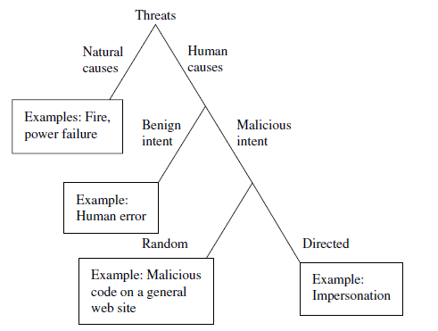
Cont.
Fig. 2.1 Kinds of Threats

Slide 6
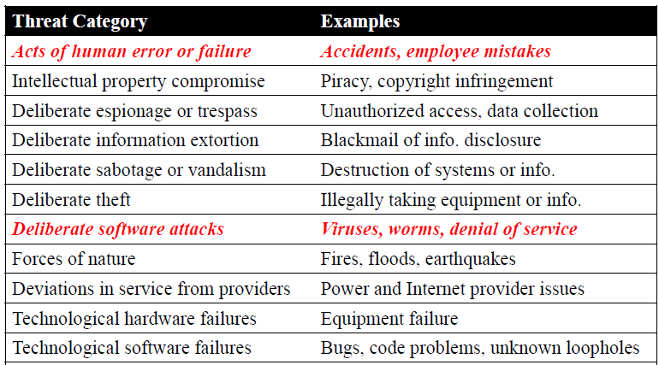
Cont.
Fig. 2.2 Threats to Information Security

Slide 7
How do we address these problems?
We use a control or countermeasure as protection.
That is, a control is an action, device, procedure, or technique that removes or reduces a vulnerability.
A threat is blocked by control of a vulnerability.
From the threat, we determine the vulnerabilities that could allow the threat to cause harm.
Finally, we explore the countermeasures that can control the threat or neutralize the vulnerability.
Thus, this is about protecting assets by countering threats that could exploit vulnerabilities.
Before we can protect assets, we have to know the kinds of harm we have to protect them against, so now we explore threats to valuable assets.

Slide 8
Reconnaissance
Reconnaissance definition states that it is a significant instrument as a starting point of numerous data hacking and for penetration testing.
The cycle includes gathering data about the target machine that could be utilized to discover its blemishes, weaknesses, and security vulnerabilities.
In the process of reconnaissance, hackers tend to be like detectives, gathering data, and information to comprehend their victims.
From looking at email records to open source data, they wish to know about the organization better than the individuals who run and look after it.
They focus on the security part of the innovation, study the shortcomings, and utilize any weakness for their potential benefit.

Slide 9
Attacks
Act or action that exploits vulnerability (i.e., an identified weakness) in controlled system.
Accomplished by threat agent which damages or steals organization’s information.
An attack can also be launched by another system, as when one system sends an overwhelming flood of messages to another, virtually shutting down the second system’s ability to function.
Unfortunately, we have seen this type of attack frequently, as denial-of-service attacks deluge servers with more messages than they can handle.
Malicious code: launching viruses, worms, Trojan horses, and active Web scripts aiming to steal or destroy information.

Slide 10
Cont.
Backdoor: accessing system or network using known or previously unknown mechanism
Password crack: attempting to reverse calculate a password
Brute force: trying every possible combination of options of a password
Dictionary: selects specific accounts to attack and uses commonly used passwords (i.e., the dictionary) to guide guesses.

Slide 11
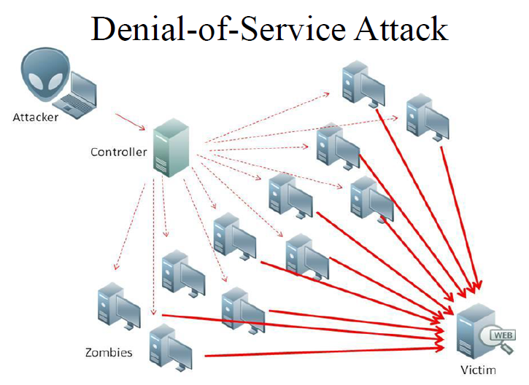
Cont.
Denial-of-service (DoS): attacker sends large number of connection or information requests to a target:
Target system cannot handle successfully along with other, legitimate service requests
May result in system crash or inability to perform ordinary functions
Distributed denial-of-service (DDoS): coordinated stream of requests is launched against target from many locations simultaneously.

Slide 12
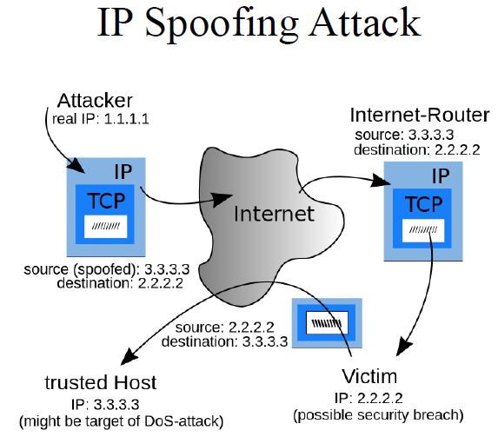
Cont.
Spoofing: technique used to gain unauthorized access; intruder assumes a trusted IP address

Slide 13
Cont.
Spam: unsolicited commercial e-mail; more a nuisance than an attack, though is emerging as a vector for some attacks.
Mail bombing: also a DoS; attacker routes large quantities of e-mail to target
Sniffers: program or device that monitors data traveling over network; can be used both for legitimate purposes and for stealing information from a network
Social engineering: using social skills to convince people to reveal access credentials or other valuable information to attacker.

Slide 14
Cont.
Man-in-the-middle: attacker monitors network packets, modifies them, and inserts them back into network

Slide 15
Cont.
Buffer overflow: application error where more data sent to a buffer than can be handled
Timing attack: explores contents of a Web browser’s cache to create malicious cookie
Side-channel attacks: secretly observes computer screen contents/electromagnetic radiation, keystroke sounds, etc.

Slide 16
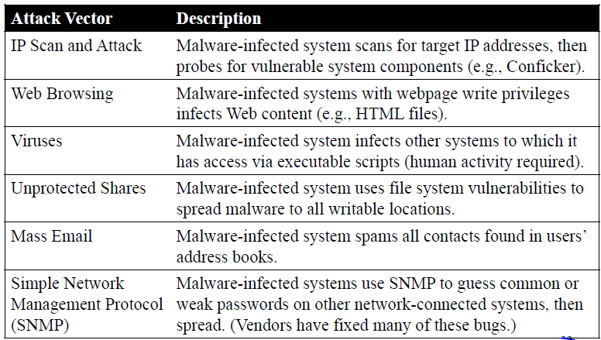
Cont.
Fig. 2.3 Attack Replication Vectors

Slide 17
Parameters on Attacks
Most computer security activity relates to malicious human-caused harm:
A malicious attacker actually wants to cause harm, and so we often use the term attack for a malicious computer security event.

Slide 18
Cont.
Malicious attacks can be random or directed.
In a random attack the attacker wants to harm any computer or user; such an attack is analogous to accosting the next pedestrian who walks down the street.
An example of a random attack is malicious code posted on a web site that could be visited by anybody.
In a directed attack, the attacker intends harm to specific computers, perhaps at one organization (think of attacks against a political organization) or belonging to a specific individual (think of trying to drain a specific person’s bank account, for example, by impersonation).

Slide 19
Cont.
Another class of directed attack is against a particular product, such as any computer running a particular browser.
(We do not want to split hairs about whether such an attack is directed—at that one software product—or random, against any user of that product; the point is not semantic perfection but protecting against the attacks.)
The range of possible directed attacks is practically unlimited.

Slide 20
Group Assignment
Review and Prepare Report on:
Security Vulnerability, Attack and Risk Assessment on Saint Mary's University( other Offices) ICT Network and Information Security
Should be submitted after one week of this class!

